Slide 1
CS460/626 : Natural Language Processing/Language Technology for the Web
(Lecture 1 – Introduction)
Pushpak Bhattacharyya
CSE Dept.,
IIT Bombay

Slide 2
Persons involved
Faculty instructors: Dr. Pushpak Bhattacharyya (www.cse.iitb.ac.in/~pb) and Dr. Om Damani (www.cse.iitb.ac.in/~damani)
TAs: Mitesh (miteshk@cse), Aditya (adityas@cse)
Course home page (to be created)
  www.cse.iitb.ac.in/~cs626-460-2008

Slide 3
Perpectivising NLP: Areas of AI and their inter-dependencies
Knowledge Representation
Search
Logic
Machine Learning
Planning
Expert Systems
NLP
Vision
Robotics

Slide 4
Web brings in new perspectives
Web 2.0
(wikipedia) In studying and/or promoting web-technology, the phrase Web 2.0 can refer to a perceived second generation of web-based communities and hosted services — such as social-networking sites, wikis, and folksonomies — which aim to facilitate creativity, collaboration, and sharing between users.
According to Tim O'Reilly, "Web 2.0 is the business revolution in the computer industry caused by the move to the Internet as platform, and an attempt to understand the rules for success on that new platform."

Slide 5
QSA Triangle
Query
Search
Analystics

Slide 6
Areas being investigated
Business Intelligence on the Internet Platform
Opinion Mining
Reputation Management
Sentiment Analysis (some observations at the end)
NLP is thought to play a key role

Slide 7
Books etc.
Main Text(s):
  Natural Language Understanding: James Allan
  Speech and NLP: Jurafsky and Martin
  Foundations of Statistical NLP: Manning and Schutze
Other References:
  NLP a Paninian Perspective: Bharati, Cahitanya and Sangal
  Statistical NLP: Charniak
Journals
  Computational Linguistics, Natural Language Engineering, AI, AI Magazine, IEEE SMC
Conferences
  ACL, EACL, COLING, MT Summit, EMNLP, IJCNLP, HLT, ICON, SIGIR, WWW, ICML, ECML

Slide 8
Allied Disciplines
Philosophy | Semantics, Meaning of “meaning”, Logic (syllogism)
Linguistics | Study of Syntax, Lexicon, Lexical Semantics etc.
Probability and Statistics | Corpus Linguistics, Testing of Hypotheses, System Evaluation
Cognitive Science | Computational Models of Language Processing, Language Acquisition
Psychology | Behavioristic insights into Language Processing, Psychological Models
Brain Science | Language Processing Areas in Brain
Physics | Information Theory, Entropy, Random Fields
Computer Sc. & Engg. | Systems for NLP

Slide 9
Topics to be covered
Shallow Processing
  Part of Speech Tagging and Chunking using HMM, MEMM, CRF, and Rule Based Systems
  EM Algorithm
Language Modeling
  N-grams
  Probabilistic CFGs
Basic Linguistics
  Morphemes and Morphological Processing
  Parse Trees and Syntactic Processing: Constituent Parsing and Dependency Parsing
Deep Parsing
  Classical Approaches: Top-Down, Bottom-UP and Hybrid Methods
  Chart Parsing, Earley Parsing
  Statistical Approach: Probabilistic Parsing, Tree Bank Corpora

Slide 10
Topics to be covered (contd.)
Knowledge Representation and NLP
  Predicate Calculus, Semantic Net, Frames, Conceptual Dependency, Universal Networking Language (UNL)
Lexical Semantics
  Lexicons, Lexical Networks and Ontology
  Word Sense Disambiguation
Applications
  Machine Translation
  IR
  Summarization
  Question Answering

Slide 11
Grading
Based on
  Midsem
  Endsem
  Assignments
  Seminar
  Project (possibly)
  Except the first two everything else in groups of 4. Weightages will be revealed soon.

Slide 12
Definitions etc.

Slide 13
What is NLP
Branch of AI
2 Goals
  Science Goal: Understand the language processing behaviour
  Engineering Goal: Build systems that analyse and generate language; reduce the man machine gap

Slide 14
The famous Turing Test: Language Based Interaction
Test conductor
Machine
Human
Can the test conductor find out which is the machine and which
the human

Slide 15
Inspired Eliza
http://www.manifestation.com/neurotoys/eliza.php3

Slide 16
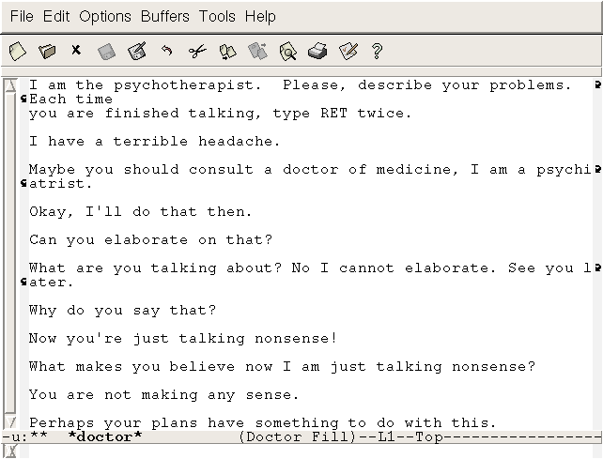
Inspired Eliza (another sample interaction)
A Sample of Interaction:

Slide 17
“What is it” question: NLP is concerned with Grounding
Ground the language into perceptual, motor and cognitive capacities.

Slide 18

Grounding
Chair
Computer

Slide 19
Grounding faces 3 challenges
Ambiguity.
Co-reference resolution (anaphora is a kind of it).
Elipsis.

Slide 20

Ambiguity
Chair

Slide 21
Co-reference Resolution
Sequence of commands to the robot:
Place the wrench on the table.
Then paint it.
What does it refer to?

Slide 22
Elipsis
Sequence of command to the Robot:
Move the table to the corner.
Also the chair.
Second command needs completing by using the first part of the previous command.

Slide 23
Two Views of NLP and the Associated Challenges
Classical View
Statistical/Machine Learning View

Slide 24
Stages of processing (traditional view)
Phonetics and phonology
Morphology
Lexical Analysis
Syntactic Analysis
Semantic Analysis
Pragmatics
Discourse

Slide 25
Phonetics
Processing of speech
Challenges
  Homophones: bank (finance) vs. bank (river
  bank)
  Near Homophones: maatraa vs. maatra (hin)
  Word Boundary
    aajaayenge (aa jaayenge (will come) or aaj aayenge (will come today)
    I got [ua]plate
  Phrase boundary
    mtech1 students are especially exhorted to attend as such seminars are integral to one's post-graduate education
  Disfluency: ah, um, ahem etc.

Slide 26
Morphology
Word formation rules from root words
Nouns: Plural (boy-boys); Gender marking (czar-czarina)
Verbs: Tense (stretch-stretched); Aspect (e.g. perfective sit-had sat); Modality (e.g. request khaanaa→ khaaiie)
First crucial first step in NLP
Languages rich in morphology: e.g., Dravidian, Hungarian, Turkish
Languages poor in morphology: Chinese, English
Languages with rich morphology have the advantage of easier processing at higher stages of processing
A task of interest to computer science: Finite State Machines for Word Morphology

Slide 27
Lexical Analysis
Essentially refers to dictionary access and obtaining the properties of the word
e.g. dog
noun (lexical property)
take-’s’-in-plural (morph property)
animate (semantic property)
4-legged (-do-)
carnivore (-do)
Challenge: Lexical or word sense disambiguation

Slide 28
Lexical Disambiguation
First step: part of Speech Disambiguation
    Dog as a noun (animal)
    Dog as a verb (to pursue)
Sense Disambiguation
    Dog (as animal)
    Dog (as a very detestable person)
Needs word relationships in a context
    The chair emphasised the need for adult education
    Very common in day to day communications
    Satellite Channel Ad: Watch what you want, when you want (two senses of watch)
    e.g., Ground breaking ceremony/research

Slide 29
Technological developments bring in new terms, additional meanings/nuances for existing terms
  Justify as in justify the right margin (word processing context)
  Xeroxed: a new verb
  Digital Trace: a new expression

Slide 30
Syntax Processing Stage
Structure Detection
S
VP
NP
V
NP
I
like
mangoes

Slide 31
Parsing Strategy
Driven by grammar
    S-> NP VP
    NP-> N | PRON
    VP-> V NP | V PP
    N-> Mangoes
    PRON-> I
    V-> like

Slide 32
Challenges in Syntactic Processing: Structural Ambiguity
Scope
    1.The old men and women were taken to safe locations
    (old men and women) vs. ((old men) and women)
    2. No smoking areas will allow Hookas inside
Preposition Phrase Attachment
    I saw the boy with a telescope
    (who has the telescope?)
    I saw the mountain with a telescope
    (world knowledge: mountain cannot be an instrument of seeing)
    I saw the boy with the pony-tail
    (world knowledge: pony-tail cannot be an instrument of seeing)
    Very ubiquitous: newspaper headline “20 years later, BMC pays father 20 lakhs for causing son’s death”

Slide 33
Structural Ambiguity…
Overheard
  I did not know my PDA had a phone for 3 months
An actual sentence in the newspaper
  The camera man shot the man with the gun when he was near Tendulkar

Slide 34
Headache for parsing: Garden Path sentences
Consider
  The horse raced past the garden (sentence complete)
  The old man (phrase complete)
  Twin Bomb Strike in Baghdad (news paper heading: complete)

Slide 35
Headache for Parsing
Garden Pathing
  The horse raced past the garden fell
  The old man the boat
  Twin Bomb Strike in Baghdad kill 25 (Times of India 5/9/07)

Slide 36
Semantic Analysis
Representation in terms of
    Predicate calculus/Semantic Nets/Frames/Conceptual Dependencies and Scripts
John gave a book to Mary
    Give action: Agent: John, Object: Book, Recipient: Mary
Challenge: ambiguity in semantic role labeling
  (Eng) Visiting aunts can be a nuisance
  (Hin) aapko mujhe mithaai khilaanii padegii (ambiguous in Marathi and Bengali too; not in Dravidian languages)

Slide 37
Pragmatics
Very hard problem
Model user intention
  Tourist (in a hurry, checking out of the hotel, motioning to the service boy): Boy, go upstairs and see if my sandals are under the divan. Do not be late. I just have 15 minutes to catch the train.
  Boy (running upstairs and coming back panting): yes sir, they are there.
World knowledge
  WHY INDIA NEEDS A SECOND OCTOBER (ToI, 2/10/07)

Slide 38
Discourse
Processing of sequence of sentences
Mother to John:
John go to school. It is open today. Should you bunk? Father will be very angry.
Ambiguity of open
bunk what?
Why will the father be angry?
Complex chain of reasoning and application of world knowledge
Ambiguity of father
  father as parent
  or
  father as headmaster

Slide 39
Complexity of Connected Text
John was returning from school dejected – today was the math test
He couldn’t control the class
Teacher shouldn’t have made him
responsible
After all he is just a janitor

Slide 40
Machine Learning and NLP

Slide 41
NLP as an ML task
France beat Brazil by 1 goal to 0 in the quarter-final of the world cup football tournament. (English)
braazil ne phraans ko vishwa kap phutbal spardhaa ke kwaartaar phaainal me 1-0 gol ke baraabarii se haraayaa. (Hindi)

Slide 42
Categories of the Words in the Sentence
France beat Brazil by 1 goal to 0 in the quarter
final of the world cup football tournament
Brazil
beat
France
1
0
goal
quarter final
world cup
Football
tournament
by
to
in
the
of
function
words
content
words

Slide 43
Further Classification 1/2
Brazil
France
1
goal
0
quarter final
world cup
football
tournament
Brazil
France
Brazil
beat
France
1
goal
0
quarter final
world cup
football
tournament
proper
noun
noun
1
goal
0
quarter final
world cup
Football
tournament
verb
common
noun
beat

Slide 44
Further Classification 2/2
by
to
In
the
of
determiner
preposition
by
to
in
of
the

Slide 45
Why all this?
information need
  who did what
  to whom
  by what
  when
  where
  in what manner

Slide 46
Semantic roles
Brazil
1 goal to 0
patient/theme
France
manner
beat
agent
time
quarter
finals
world
cup
football
modifier

Slide 47
Semantic Role Labeling: a classification task
France beat Brazil by 1 goal to 0 in the quarter-final of the world cup football tournament
  Brazil: agent or object?
  Agent: Brazil or France or Quarter Final or World Cup?
Given an entity, what role does it play?
Given a role, it is played by which entity?

Slide 48
A lower level of classification: Part of Speech (POS) Tag Labeling
France beat Brazil by 1 goal to 0 in the quarter-final of the world cup football tournament
  beat: verb of noun (heart beat, e.g.)?
  Final: noun or adjective?

Slide 49
Uncertainty in classification: Ambiguity
Visiting aunts can be a nuisance
  Visiting:
    adjective or gerund (POS tag ambiguity)
  Role of aunt:
    agent of visit (aunts are visitors)
    object of visit (aunts are being visited)
Minimize uncertainty of classification with cues from the sentence

Slide 50
What cues?
Position with respect to the verb:
  France to the left of beat and Brazil to the right: agent-object role marking (English)
Case marking:
  France ne (Hindi); ne (Marathi): agent role
  Brazil ko (Hindi); laa (Marathi): object role
Morphology: haraayaa (hindi); haravlaa (Marathi):
  verb POS tag as indicated by the distinctive suffixes

Slide 51
Cues are like attribute-value pairs prompting machine learning from NL data
Constituent ML tasks
  Goal: classification or clustering
  Features/attributes (word position, morphology, word label etc.)
  Values of features
  Training data (corpus: annotated or un-annotated)
  Test data (test corpus)
  Accuracy of decision (precision, recall, F-value, MAP etc.)
  Test of significance (sample space to generality)

Slide 52
What is the output of an ML-NLP System (1/2)
Option 1: A set of rules, e.g.,
  If the word to the left of the verb is a noun and has animacy feature, then it is the likely agent of the action denoted by the verb.
    The child broke the toy (child is the agent)
    The window broke (window is not the agent; inanimate)

Slide 53
What is the output of an ML-NLP System (2/2)
Option 2: a set of probability values
  P(agent|word is to the left of verb and has animacy) > P(object|word is to the left of verb and has animacy)> P(instrument|word is to the left of verb and has animacy) etc.

Slide 54
How is this different from classical NLP
The burden is on the data as opposed to the human.
Classical NLP
Linguist
rules
Computer
rules/probabilities
Text data
corpus
Statistical NLP

Slide 55
Classification appears as sequence labeling

Slide 56
A set of Sequence Labeling Tasks: smaller to larger units
Words:
  Part of Speech tagging
  Named Entity tagging
  Sense marking
Phrases: Chunking
Sentences: Parsing
Paragraphs: Co-reference annotating

Slide 57
Example of word labeling: POS Tagging
<s>
Come January, and the IIT campus is abuzz with new and returning students.
</s>
<s>
Come_VB January_NNP ,_, and_CC the_DT IIT_NNP campus_NN is_VBZ abuzz_JJ with_IN new_JJ and_CC returning_VBG students_NNS ._.
</s>

Slide 58
Example of word labeling: Named Entity Tagging
<month_name>
January
</month_name>
<org_name>
IIT
</org_name>

Slide 59
Example of word labeling: Sense Marking
Word Synset WN-synset-no
come {arrive, get, come} 01947900
.
.
.
abuzz {abuzz, buzzing, droning} 01859419

Slide 60
Example of phrase labeling: Chunking
Come July, and is
abuzz with .
the IIT campus
new and returning students

Slide 61
Example of Sentence labeling: Parsing
[_{S1}[_{S}[_{S}[_{VP}[_{VB}Come][_{NP}[_{NNP}July]]]]
[,,]
[_{CC} and]
[_{S} [_{NP} [_{DT} the] [_{JJ} IIT] [_{NN} campus]]
[_{VP} [_{AUX} is]
[_{ADJP} [_{JJ} abuzz]
[_{PP}[_{IN} with]
[_{NP}[_{ADJP} [_{JJ} new] [_{CC} and] [ _{VBG} returning]]
[_{NNS} students]]]]]]
[..]]]

Slide 62
Modeling Through the Noisy Channel
5 problems in NLP

Slide 63
5 Classical Problems in NLP: being tackled now by statistical approaches
Part of Speech Tagging
Statistical Spell Checking
Automatic Speech Recognition
Probabilistic Parsing
Statistical Machine Translation

Slide 64
Problem-1: PoS tagging
Input:
sentences (string of words to be tagged)
tagset
Output: single best tag for each word

Slide 65
PoS tagging: Example
Sentence:
The national committee remarked on a number of other issues.
Tagged output:
The/DET national/ADJ committee/NOU remarked/VRB on/PRP a/DET number/NOU of/PRP other/ADJ issues/NOU.

Slide 66
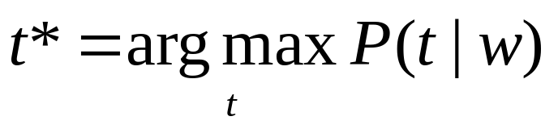
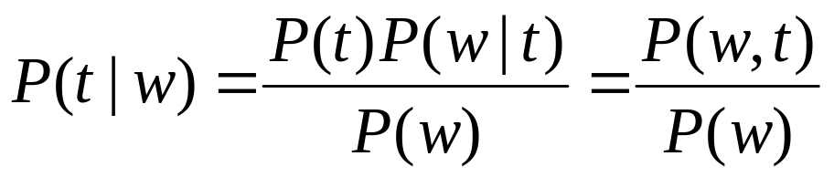


Stochastic Models (Contd..)
Best tag t*,
Bayes Rule gives,
Joint Distribution
Conditional Distribution

Slide 67
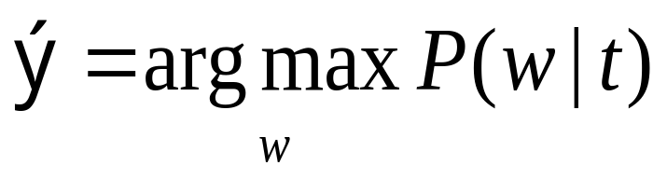
Problem 2: Probabilistic Spell Checker
  w t
  (w_{n}, w_{n-1}, … , w₁) (t_{m}, t_{m-1}, … , t₁)
Noisy Channel
Given t, find the most probable w : Find that ŵ for which P(w|t) is maximum, where t, w and ŵ are strings:
ŵ
Guess at the correct word
Correct word
Wrongly spelt word

Slide 68
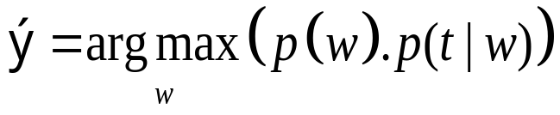
Spell checker: apply Bayes Rule
Why apply Bayes rule?
  Finding p(w|t) vs. p(t|w) ?
p(w|t) or p(t|w) have to be computed by counting c(w,t) or c(t,w) and then normalizing them
Assumptions :
  t is obtained from w by a single error.
  The words consist of only alphabets
ŵ

Slide 69
Spell checker: Confusion Matrix (1/3)
Confusion Matrix: 26x26
Data structure to store c(a,b)
Different matrices for insertion, deletion, substitution and transposition
Substitution
  The number of instances in which a is wrongly substituted by b in the training corpus (denoted sub(x,y) )

Slide 70
Confusion Matrix (2/3)
Insertion
  The number of times a letter y is inserted after x wrongly( denoted ins(x,y) )
Transposition
  The number of times xy is wrongly transposed to yx ( denoted trans(x,y) )
Deletion
  The number of times y is deleted wrongly after x ( denoted del(x,y) )

Slide 71
Confusion Matrix (3/3)
If x and y are alphabets,
  sub(x,y) = # times y is written for x (substitution)
  ins(x,y) = # times x is written as xy
  del(x,y) = # times xy is written as x
  trans(x,y) = # times xy is written as yx

Slide 72
Probabilities from confusion matrix
P(t|w)= P(t|w)_{S} + P(t|w)_{I} + P(t|w)_{D} + P(t|w)_{X}
where
  P(t|w)_{S} = sub(x,y) / count of x
  P(t|w)_{I} = ins(x,y) / count of x
  P(t|w)_{D} = del(x,y) / count of x
  P(t|w)_{X} = trans(x,y) / count of x
These are considered to be mutually exclusive events

Slide 73
Spell checking: Example
Correct document has w_{s}
Wrong document has t_{s}
P(maple|aple)=
  # (maple was wanted instead of aple) / # (aple)
P(apple|aple) and P(applet|aple) calculated similarly
Leads to problems due to data sparsity.
Hence, use Bayes rule.

Slide 74
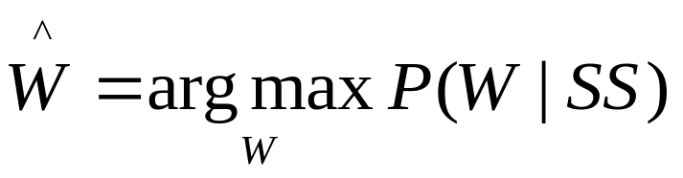
Problem 3: Probabilistic Speech Recognition
Problem Definition : Given a sequence of speech signals, identify the words.
2 steps :
  Segmentation (Word Boundary Detection)
  Identify the word
Isolated Word Recognition :
  Identify W given SS (speech signal)

Slide 75
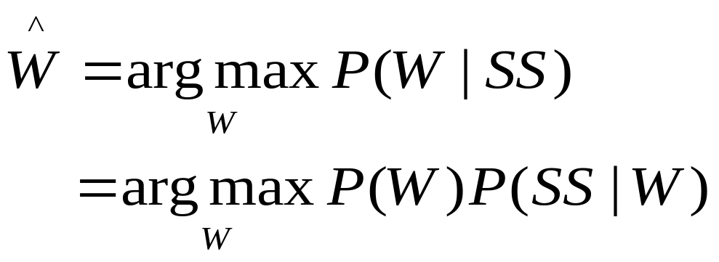

Speech recognition: Identifying the word
P(SS|W) = likelihood called “phonological model “ → intuitively more tractable!
P(W) = prior probability called “language model”

Slide 76
Pronunciation Dictionary
Word
Pronunciation Automaton
s₄
0.73
ae
1.0
1.0
1.0
1.0
1.0
Tomato
t
o
m
t
o
end
0.27
1.0
s₁
s₂
s₃
aa
s₆
s₇
s₅
P(SS|W) is maintained in this way.
P(t o m ae t o |Word is “tomato”) = Product of arc probabilities

Slide 77
Problem 4: Statistical Machine Translation
Source language sentences
Noisy Channel
Target language sentences
What sentence in the target language will maximise the probability
P(target sentence|source sentence)

Slide 78
Statistical MT: Parallel Texts
Observation:
Parallel texts
  Instruction manuals
  Hong Kong legislation
  Macao legislation
  Canadian parliament Hansards
  United nation reports
  Official journal of the European Communities
  Trilingual documents in Indian states
Every time I see banco, the
translation is bank or bench
… if it is banco de, then it
always becomes bank and
never bench
Courtsey: a presentation by K. Knight

Slide 79
SMT: formalism
Source language: F
Target language: E
Source language sentence: f
Target language sentence: e
Source language word: w_{f}
Target language word: w_{e}

Slide 80
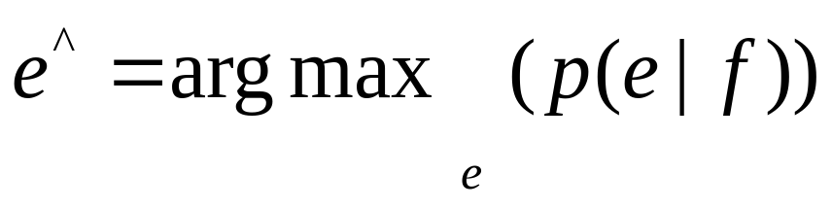
SMT Model
To translate f:
  Assume that all sentences in E are translations of f with some probability!
  Choose the translation with the highest probability

Slide 81
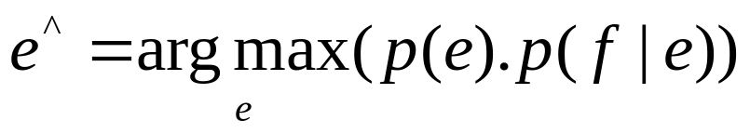
SMT: Apply Bayes Rule
P(e) is called the language model and
stands for fluency
and
P(f|e} is called the translation model and
stands for faithfulness

Slide 82
Reason for Applying Bayes Rule
The way P(f|e) and P(e|f) are usually calculated
  Word translation based
  Word order
  Collocations (For example, strong tea)
Example:
  f: It is raining
  Candidates for e (in Hindi):
    bAriSa Ho raHI HE (rain happening is)
    Ho bAriSa raHI HE (is rain happening)
    bAriSa Ho raHA HE (rain happening_masculine is)

Slide 83
Is NLP Really Needed

Slide 84
Post-1
POST----5 TITLE: "Wants to invest in IPO? Think again" | <br /><br />Here&acirc;&euro;&trade;s a sobering thought for those who believe in investing in IPOs. Listing gains &acirc;&euro;&rdquo; the return on the IPO scrip at the close of listing day over the allotment price &acirc;&euro;&rdquo; have been falling substantially in the past two years. Average listing gains have fallen from 38% in 2005 to as low as 2% in the first half of 2007.Of the 159 book-built initial public offerings (IPOs) in India between 2000 and 2007, two-thirds saw listing gains. However, these gains have eroded sharply in recent years.Experts say this trend can be attributed to the aggressive pricing strategy that investment bankers adopt before an IPO. &acirc;&euro;&oelig;While the drop in average listing gains is not a good sign, it could be due to the fact that IPO issue managers are getting aggressive with pricing of the issues,&acirc;&euro; says Anand Rathi, chief economist, Sujan Hajra.While the listing gain was 38% in 2005 over 34 issues, it fell to 30% in 2006 over 61 issues and to 2% in 2007 till mid-April over 34 issues. The overall listing gain for 159 issues listed since 2000 has been 23%, according to an analysis by Anand Rathi Securities.Aggressive pricing means the scrip has often been priced at the high end of the pricing range, which would restrict the upward movement of the stock, leading to reduced listing gains for the investor. It also tends to suggest investors should not indiscriminately pump in money into IPOs.But some market experts point out that India fares better than other countries. &acirc;&euro;&oelig;Internationally, there have been periods of negative returns and low positive returns in India should not be considered a bad thing.

Slide 85
Post-2
POST----7TITLE: "[IIM-Jobs] ***** Bank: International Projects Group - Manager"| <br />Please send your CV &amp; cover letter to anup.abraham@*****bank.com ***** Bank, through its International Banking Group (IBG), is expanding beyond the Indian market with an intent to become a significant player in the global marketplace. The exciting growth in the overseas markets is driven not only by India linked opportunities, but also by opportunities of impact that we see as a local player in these overseas markets and / or as a bank with global footprint. IBG comprises of Retail banking, Corporate banking &amp; Treasury in 17 overseas markets we are present in. Technology is seen as key part of the business strategy, and critical to business innovation &amp; capability scale up. The International Projects Group in IBG takes ownership of defining &amp; delivering business critical IT projects, and directly impact business growth. Role: Manager &Acirc;&ndash; International Projects Group Purpose of the role: Define IT initiatives and manage IT projects to achieve business goals. The project domain will be retail, corporate &amp; treasury. The incumbent will work with teams across functions (including internal technology teams &amp; IT vendors for development/implementation) and locations to deliver significant &amp; measurable impact to the business. Location: Mumbai (Short travel to overseas locations may be needed) Key Deliverables: Conceptualize IT initiatives, define business requirements

Slide 86
Sentiment Classification
Positive, negative, neutral – 3 class
Sports, economics, literature - multi class
Create a representation for the document
Classify the representation
The most popular way of representing a document is feature vector (indicator sequence).

Slide 87
Established Techniques
Naïve Bayes Classifier (NBC)
Support Vector Machines (SVM)
Neural Networks
K nearest neighbor classifier
Latent Semantic Indexing
Decision Tree ID3
Concept based indexing

Slide 88
Successful Approaches
The following are successful approaches as reported in literature.
NBC – simple to understand and implement
SVM – complex, requires foundations of perceptions

Slide 89
Mathematical Setting
We have training set
  A: Positive Sentiment Docs
  B: Negative Sentiment Docs
  Let the class of positive and negative documents be C₊ and C₋ , respectively.
  Given a new document D label it positive if
Indicator/feature
vectors to be formed
  P(C₊|D) > P(C₋|D)

Slide 90
Priori Probability
Document | Vector | Classification
D1 | V1 | +
D2 | V2 | -
D3 | V3 | +
.. | .. | ..
D₄₀₀₀ | V₄₀₀₀ | -
Let T = Total no of documents
And let |+| = M
So,|-| = T-M
Priori probability is calculated without considering any features of the new document.
P(D being positive)=M/T

Slide 91
Apply Bayes Theorem
Steps followed for the NBC algorithm:
Calculate Prior Probability of the classes. P(C₊ ) and P(C₋)
Calculate feature probabilities of new document. P(D| C₊ ) and P(D| C₋)
Probability of a document D belonging to a class C can be calculated by Baye’s Theorem as follows:
  P(C|D) = P(C) * P(D|C)
  P(D)
Document belongs to C₊ , if
  P(C₊ ) * P(D|C₊) > P(C₋ ) * P(D|C₋)

Slide 92
Calculating P(D|C₊)
P(D|C₊) is the probability of class C₊ given D. This is calculated as follows:
Identify a set of features/indicators to evaluate a document and generate a feature vector (V_{D}). V_{D} = <x₁ , x₂ , x₃ … x_{n} >
Hence, P(D|C₊) = P(V_{D}|C₊)
= P( <x₁ , x₂ , x₃ … x_{n} > | C₊)
        = |<x1,x2,x3…..xn>, C₊ |
        | C₊ |
Based on the assumption that all features are Independently Identically Distributed (IID)
        = P( <x₁ , x₂ , x₃ … x_{n} > | C₊ )
        = P(x₁ |C₊) * P(x₂ |C₊) * P(x₃ |C₊) *…. P(x_{n} |C₊)
        =∏ _{i=1} ^{n} P(x_{i} |C₊)
P(x_{i} |C₊) can now be calculated as |x_{i} |
|C₊ |

Slide 93
Baseline Accuracy
Just on Tokens as features, 80% accuracy
20% probability of a document being misclassified
On large sets this is significant

Slide 94
To improve accuracy…
Clean corpora
POS tag
Concentrate on critical POS tags (e.g. adjective)
Remove ‘objective’ sentences ('of' ones)
Do aggregation
Use minimal to sophisticated NLP

